Slide 1
Structure in Neural Activity during Observed and Executed Movements Is Shared at the Neural Population Level, Not in Single Neurons
Jiang X., Saggar H., Ryu S.I., Shenoy K.V., and Kao J.C.
Presented by: James Goodman
NBL Journal Club
08.12.2020

Slide 2
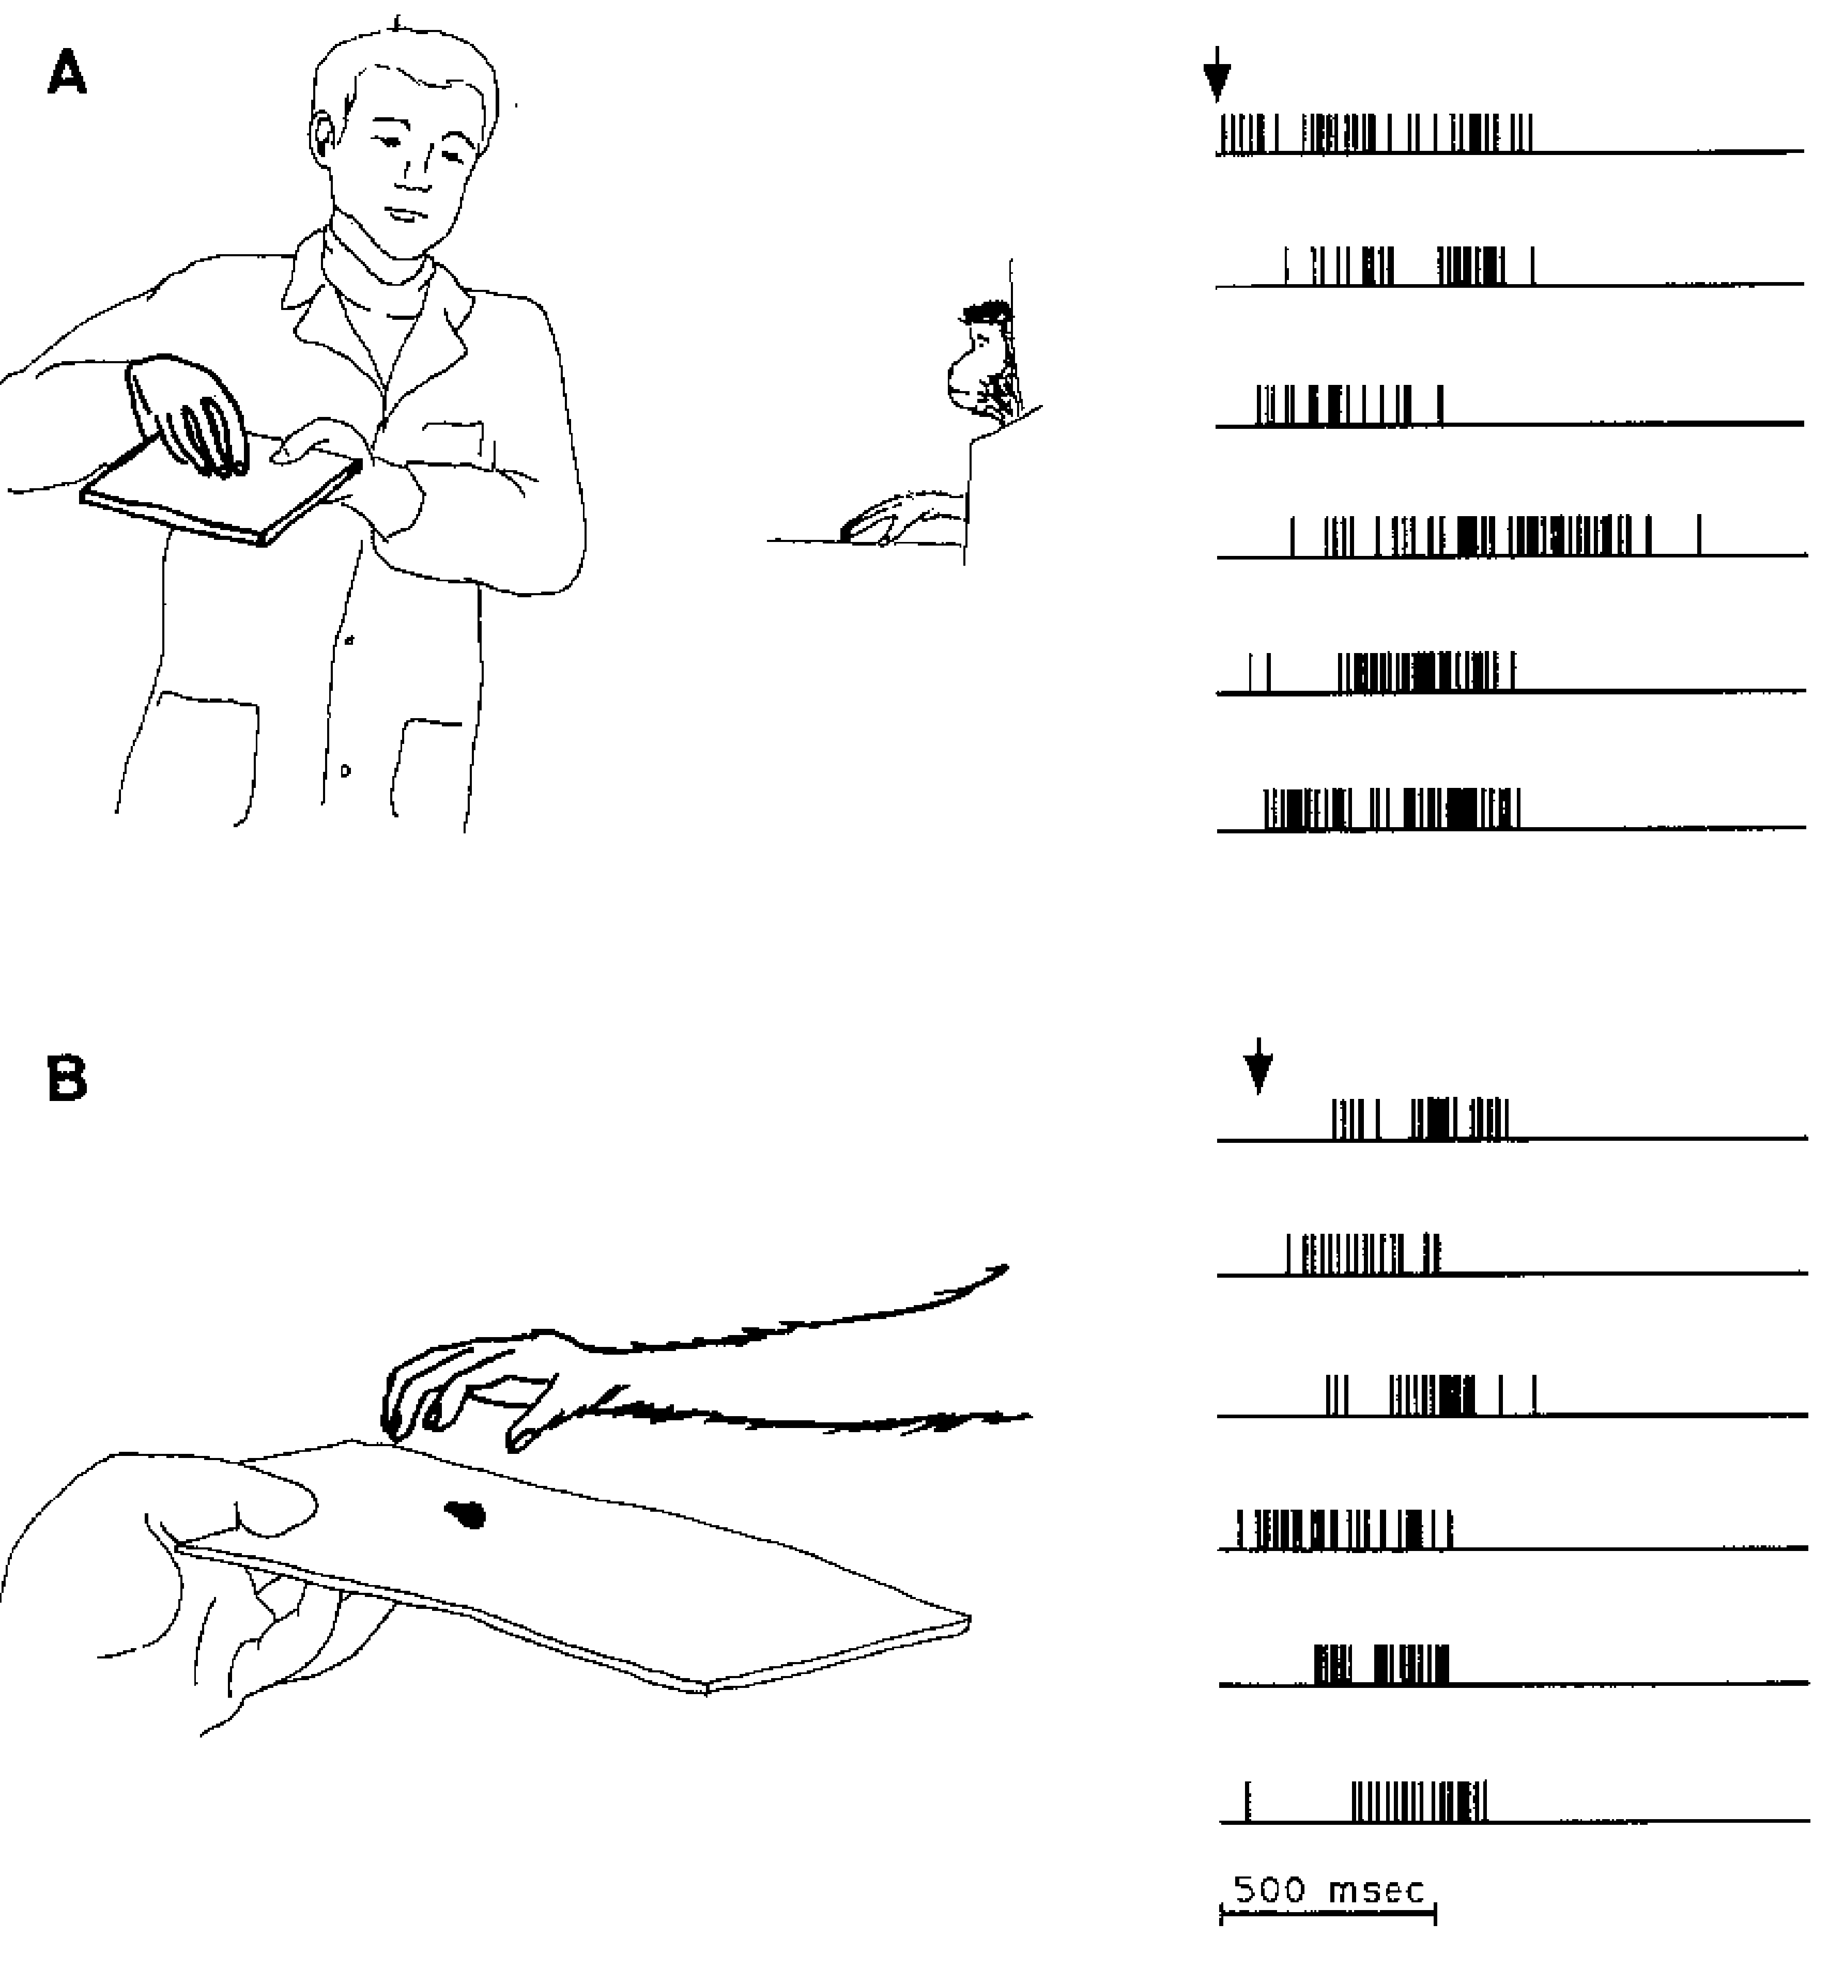
Mirror Neurons respond during action and observation
Observation
Action
di Pellegrino et al. 1992 Exp. Br. Res.

Slide 3
Mirror neurons: a contentious, possibly overhyped concept
2017 Neuron
2013 Curr. Biol.
2009 J Cog. Neuro.
Notes:
Source of controversy is actually: WHAT behavior is this actually important for?

Slide 4
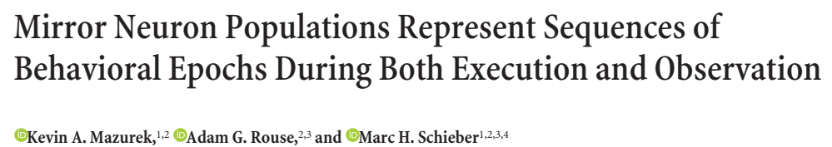
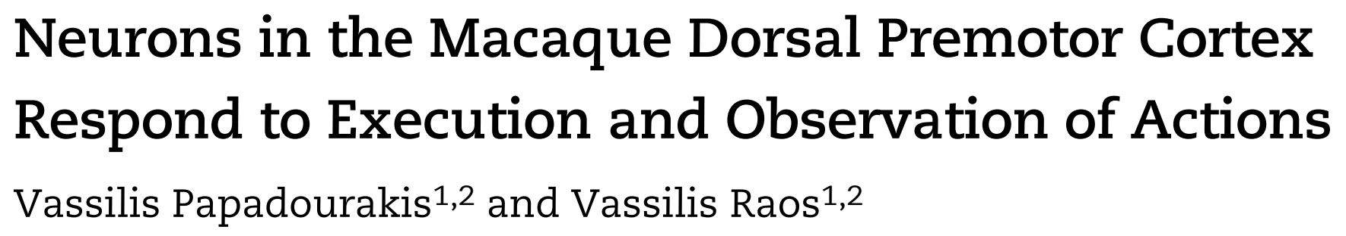

"Mirror mechanism" may be better understood in neuronal state space
2018 J Neurosci.
2019 Cereb. Cortex
2020 eLife
Notes:
…but lately people are tackling the lower-hanging fruit: new population methods, let's apply them to this mirror neuron thing!

Slide 5
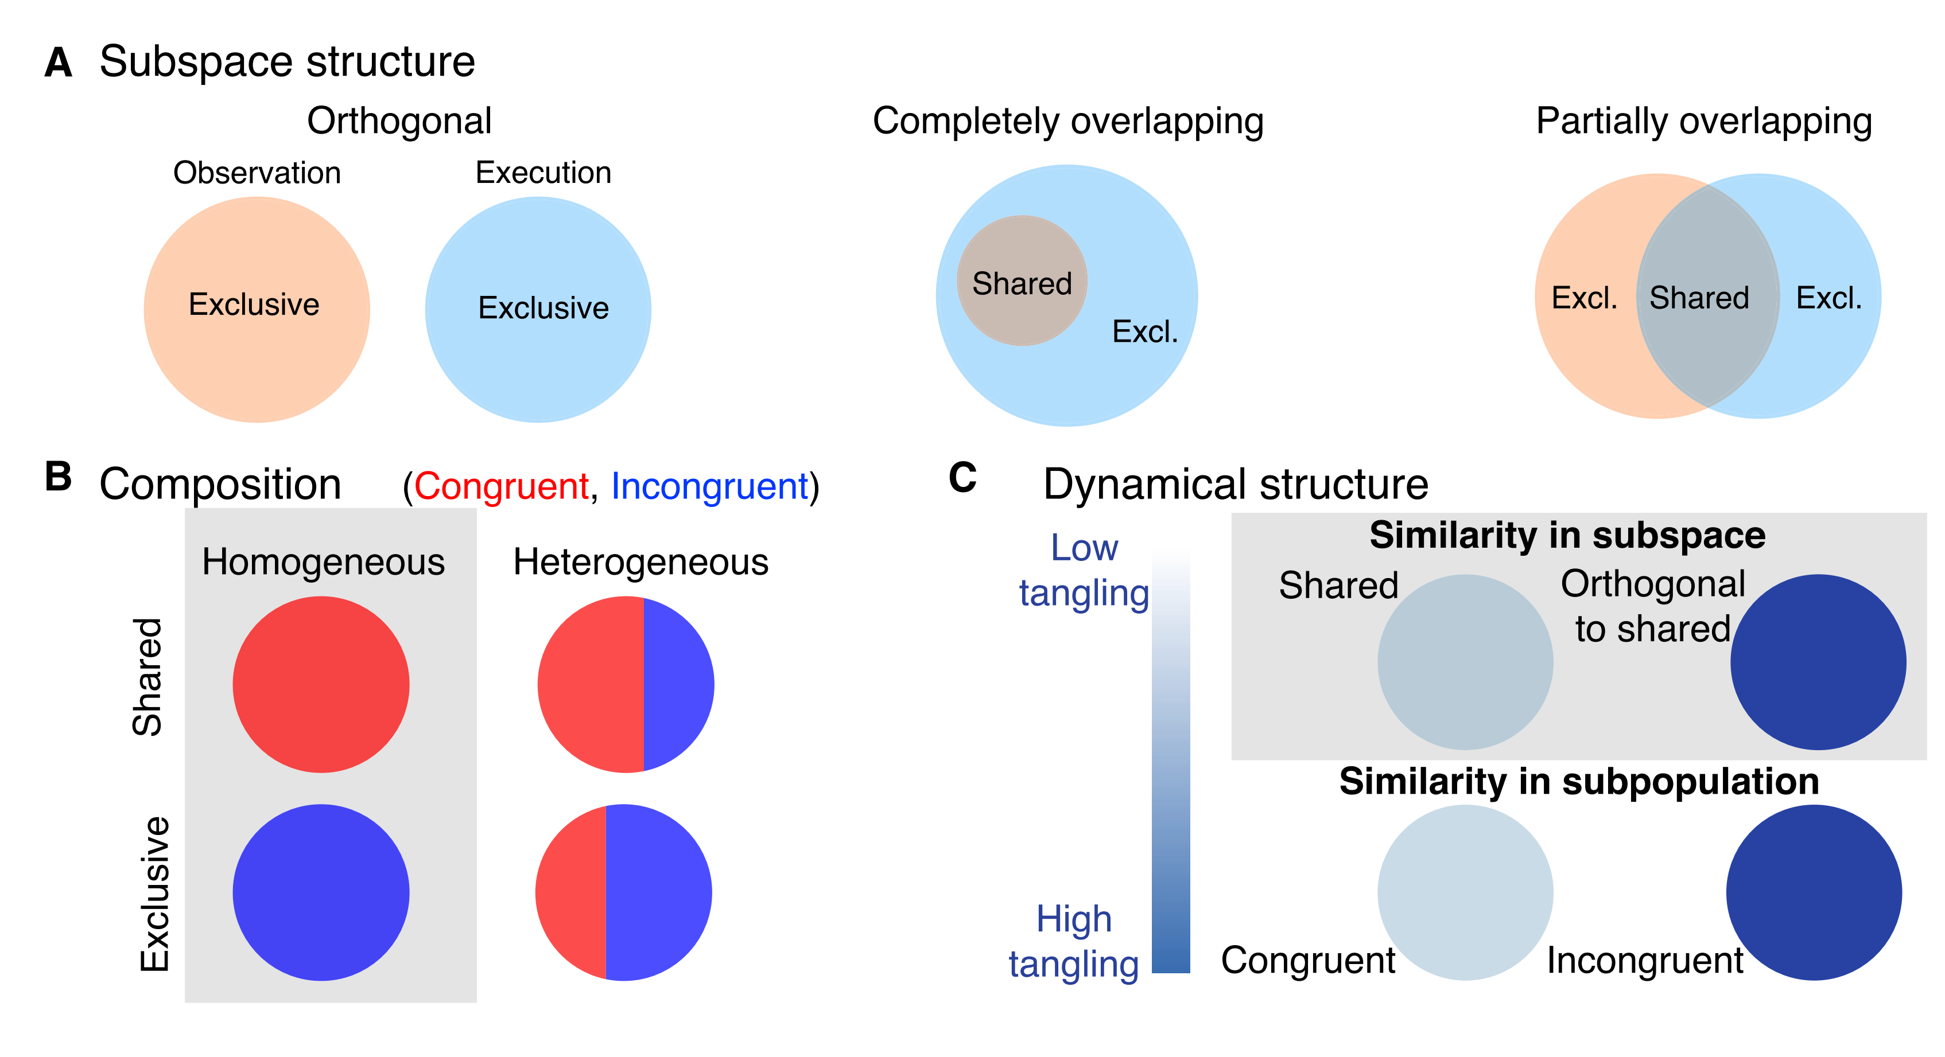
Hypotheses of population structure

Slide 6
A: Is observation activity orthogonal to, a subspace of, or partially overlapping with execution activity?

Slide 7
B: Given an overlapping subspace, does it comprise a special set of "congruent" neurons? Or a heterogeneous mixture?

Slide 8
C: Is dynamical structure preferentially preserved among "congruent" neurons? Or in a general shared subspace?
Notes:
Take note: the subspace hypothesis is FAR less constrained than the congruent neurons hypothesis
So it's bound to just offer a less noisy (more "dynamical") estimate of the first few principal components of neural activity

Slide 9
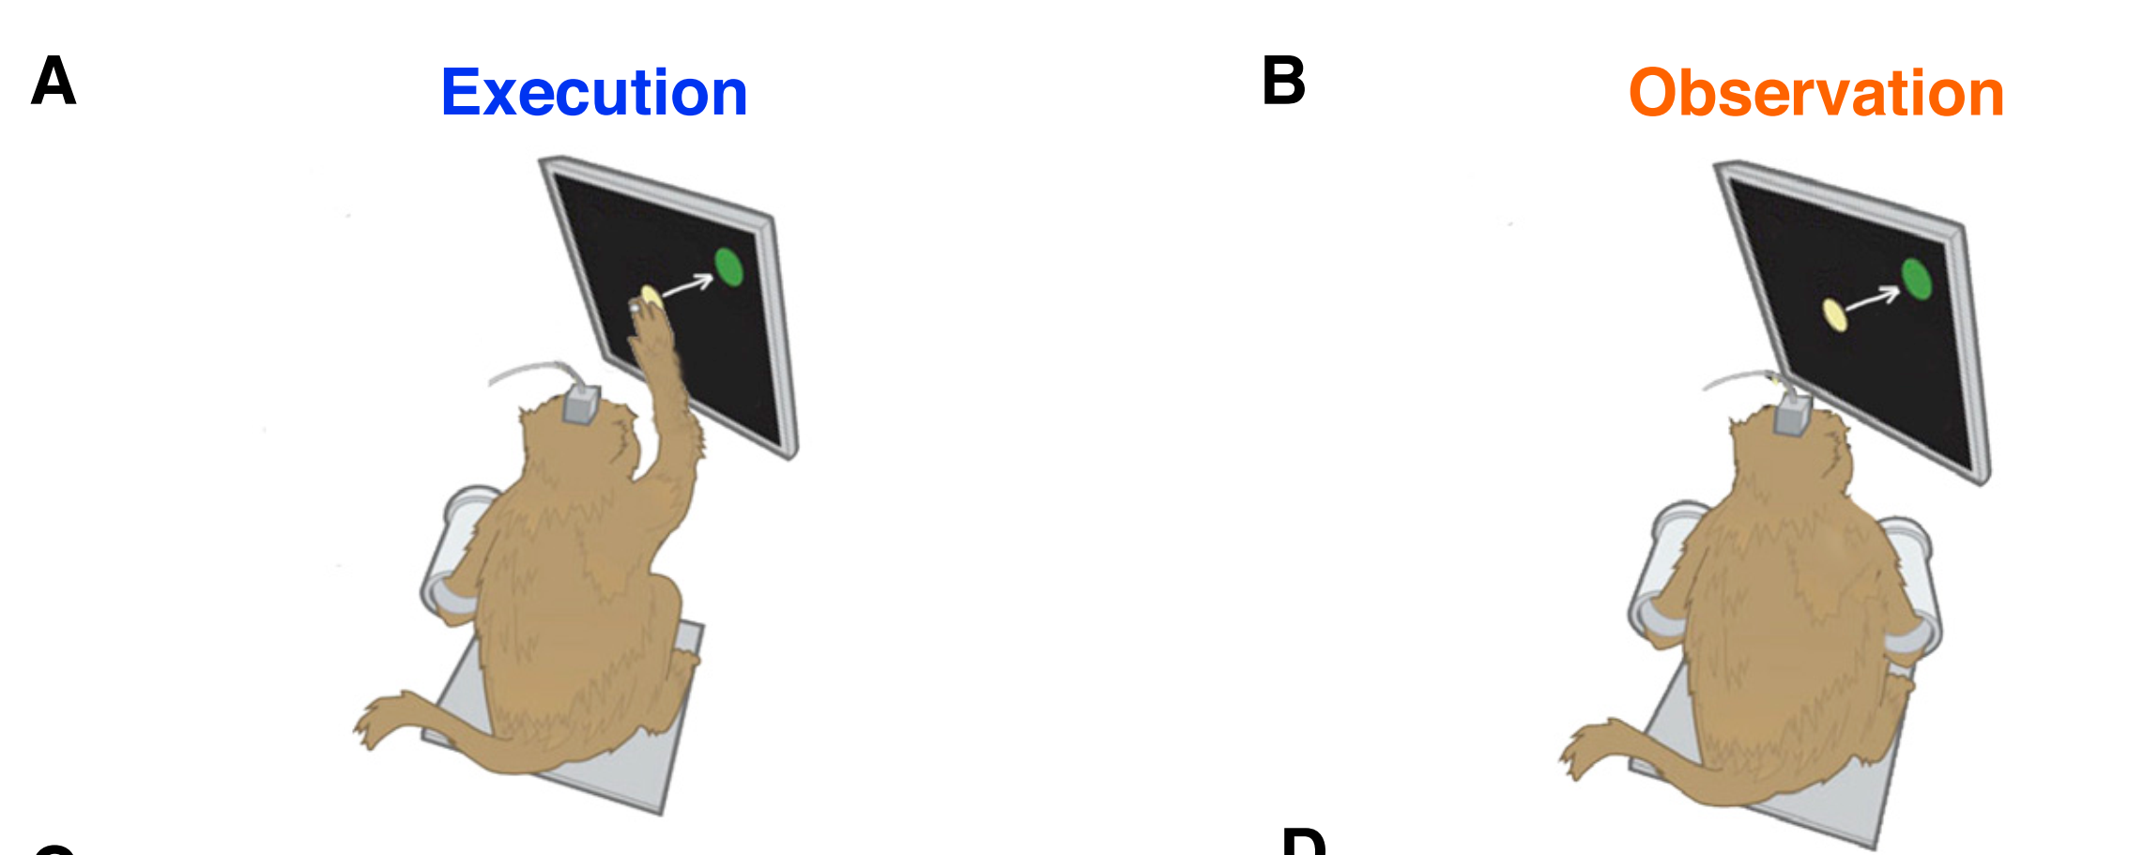
Movement execution and observation experiments
Notes:
"Center-out-and-back" task
Only analyzed the "center-out" component
Recordings are done with Utah arrays in M1 / PMd (they tend to treat the two as one & the same)

Slide 10
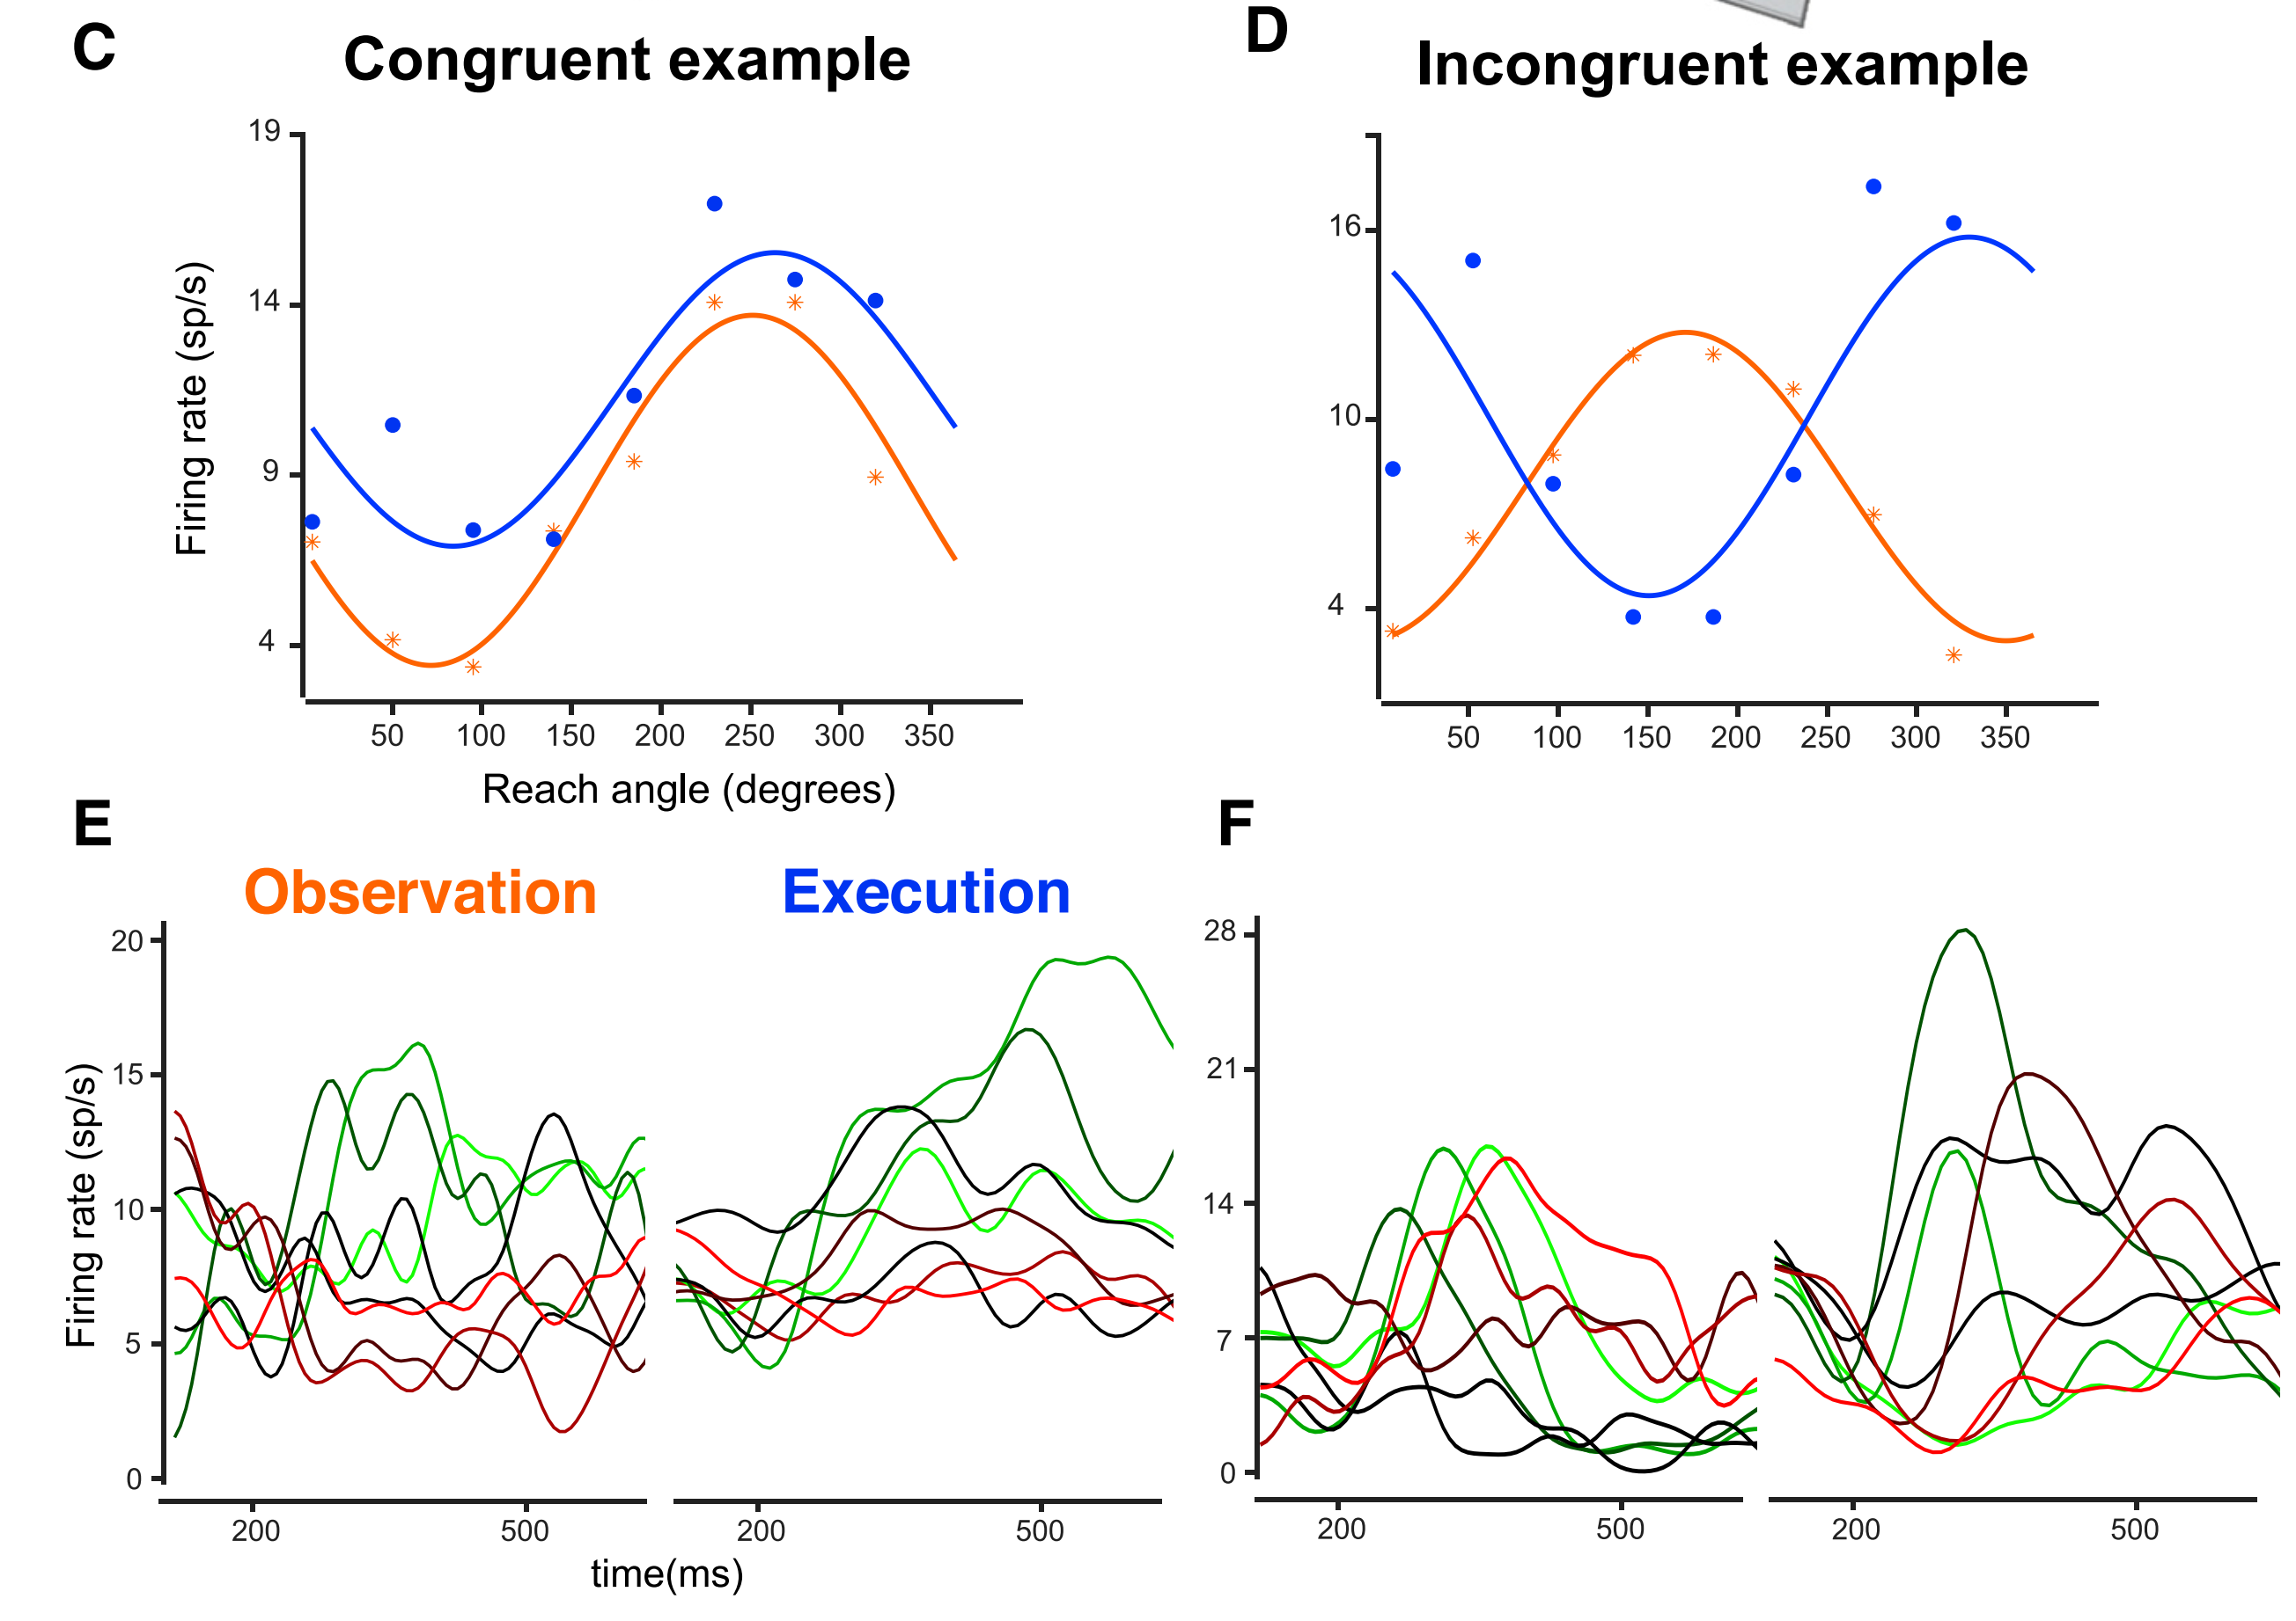
Some neurons could be clustered into congruent and incongruent varieties...
Notes:
Note that the dynamics – the "wiggles" – can vary quite wildly even among "congruent" neurons

Slide 11
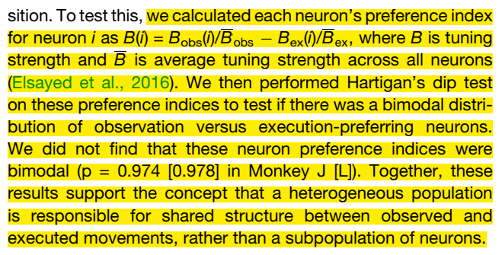
…but there's little evidence for distinct functional classes

Slide 12
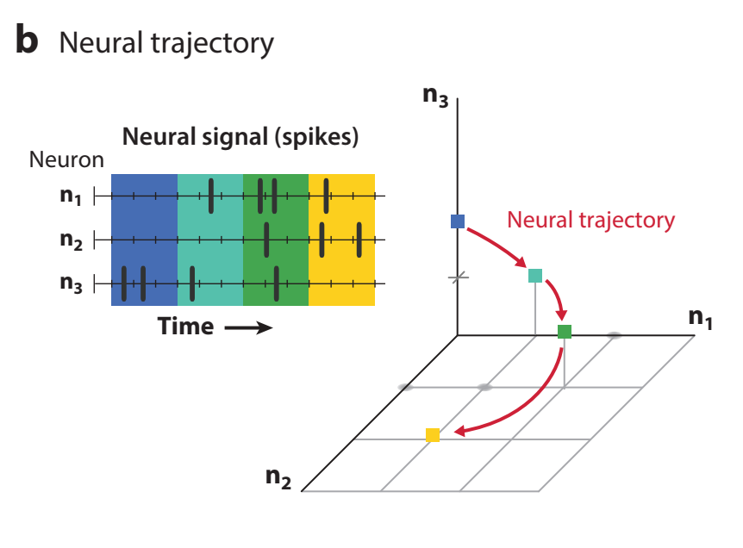
Mixed, messy population justifies state space analysis!
Vyas et al. 2020 Annu. Rev. Neurosci.

Slide 13
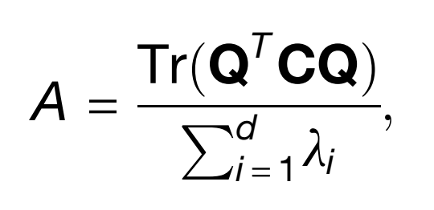
Normalized variance captured in a subspace

Slide 14
Normalized variance captured in a subspace
Q: 10-D orthonormal basis
Can be:
Top 10 Execution PCs
Top 10 Observation PCs
Randomly-generated from a uniform spherical distribution

Slide 15
Normalized variance captured in a subspace
C: Firing rate covariance matrix
Can be:
Observation covariance
Execution covariance

Slide 16
Normalized variance captured in a subspace
λ: Eigenvalue of C
(d = 10 here)

Slide 17
Normalized variance captured in a subspace
Q: 10-D orthonormal basis
Can be:
Top 10 Execution PCs
Top 10 Observation PCs
Randomly-generated from a uniform spherical distribution
C: Firing rate covariance matrix
Can be:
Observation covariance
Execution covariance
λ: Eigenvalue of C
(d = 10 here)

Slide 18
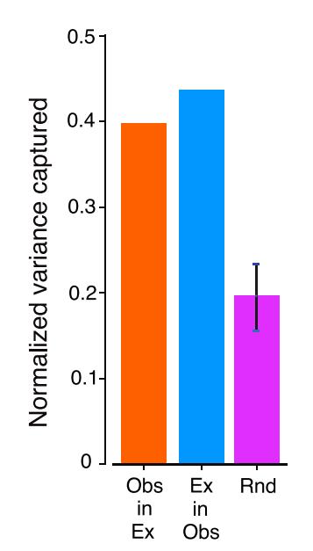
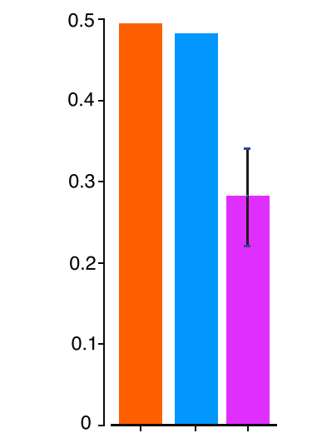
Observation and execution subspaces are not orthogonal
Monkey 1
Monkey 2
CROSS-projections
Notes:
Top 10 PCs
Pink bar is what would be expected when assigning randomly-generated subspaces to Exec and Obs

Slide 19
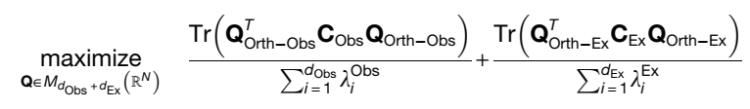
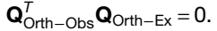
Are we sure about that? Explicitly seeking orthogonal subspaces
Subject to:

Slide 20
Are we sure about that? Explicitly seeking orthogonal subspaces
Subject to:

Slide 21
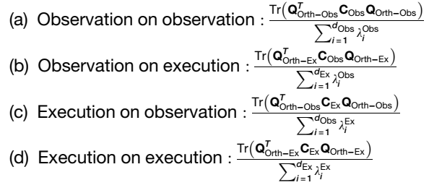
Are we sure about that? Explicitly seeking orthogonal subspaces
Subject to:
Notes:
Here, D=4

Slide 22
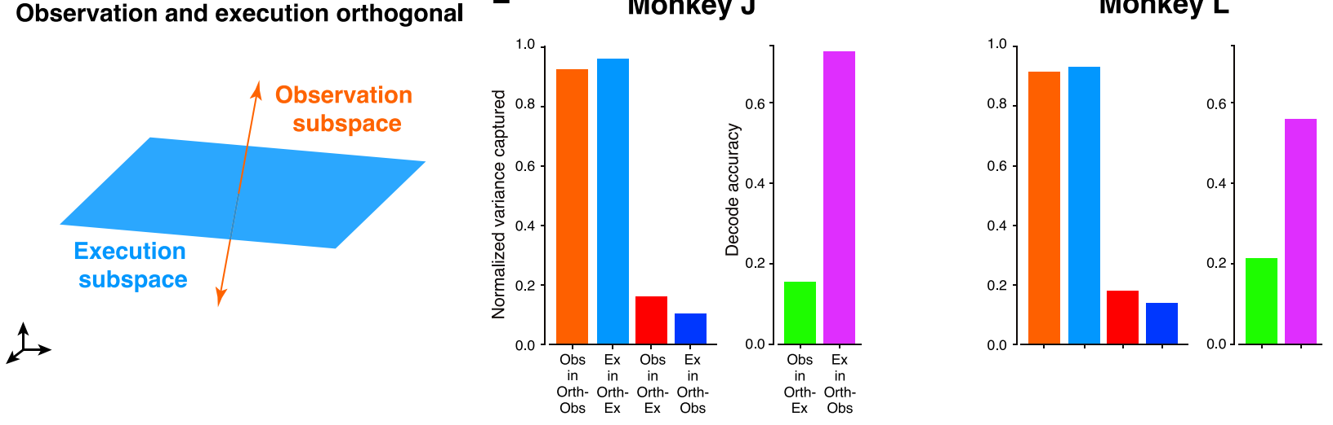
"Orthogonal" subspaces contain nonzero, information-rich neural variance
Monkey 1
Monkey 2
Chance
Notes:
Although the richness of that information is one-directional
Suggesting that perhaps the information-poor condition (observation) may comprise a subspace of execution activity

Slide 23
"Orthogonal" subspaces contain nonzero, information-rich neural variance
Monkey 1
Monkey 2
Chance
Notes:
Although the richness of that information is one-directional
Suggesting that perhaps the information-poor condition (observation) may comprise a subspace of execution activity

Slide 24
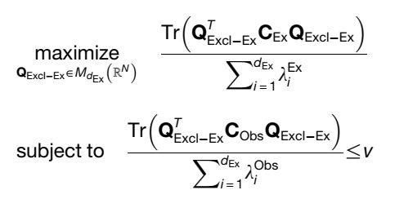
Is observation activity a subset of execution activity? Seeking "exclusive" subspaces
(and vice-versa)
Notes:
i.e., can we find substantial variance in one condition that is avoided by the other?
If not, they are probably subsets of one another
Here, v = 0.01
We saw that trying to orthogonalize our 4-D projections didn't work so well because of variance outside of those 4D subspaces
So here, we make ABSOLUTELY sure that the 4D manifolds we find are indeed "exclusive" (I assume it's still 4D by the way: they never actually specify how high-dimensional THESE projections are…)

Slide 25
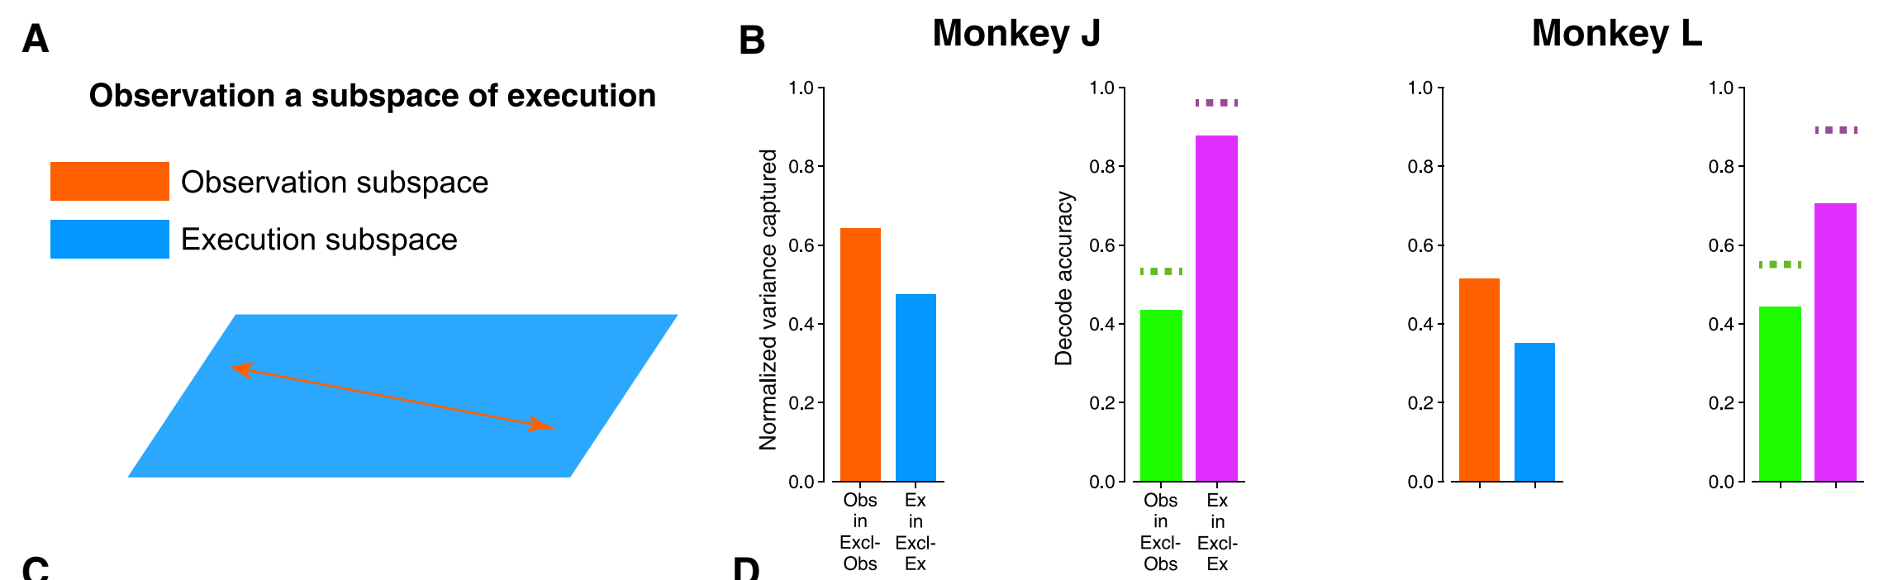
Substantial "exclusive" subspaces show that observation activity is not a subset of execution activity
Full
Chance
Notes:
We see we have a variance captured penalty
Buuuut we can still classify with it
And importantly there's plenty of signal about the target to be found in the observation-exclusive subspace
Moreover, (this isn't shown, but important), when projecting execution activity in the excl-obs subspace, we get chance performance

Slide 26
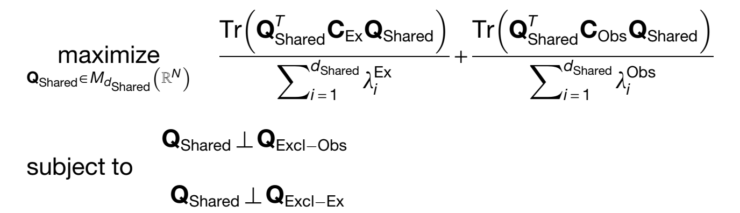
Is the shared subspace meaningful? Seeking the "shared" subspace
Notes:
i.e., can we find substantial variance in one condition that is avoided by the other?
If not, they are probably subsets of one another
Here, v = 0.01
We saw that trying to orthogonalize our 4-D projections didn't work so well because of variance outside of those 4D subspaces
So here, we make ABSOLUTELY sure that the 4D manifolds we find are indeed "exclusive" (I assume it's still 4D by the way: they never actually specify how high-dimensional THESE projections are…)

Slide 27
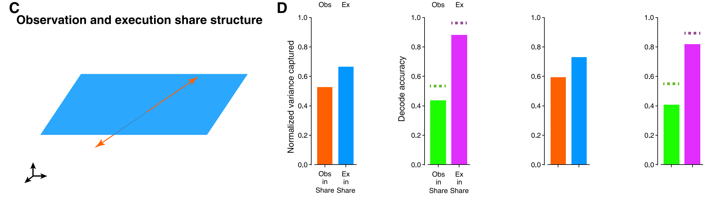
The shared subspace captures substantial, information-rich variance
Monkey J
Monkey L
Notes:
i.e., can we find substantial variance in one condition that is avoided by the other?
If not, they are probably subsets of one another
Here, v = 0.01
We saw that trying to orthogonalize our 4-D projections didn't work so well because of variance outside of those 4D subspaces
So here, we make ABSOLUTELY sure that the 4D manifolds we find are indeed "exclusive" (I assume it's still 4D by the way: they never actually specify how high-dimensional THESE projections are…)

Slide 28
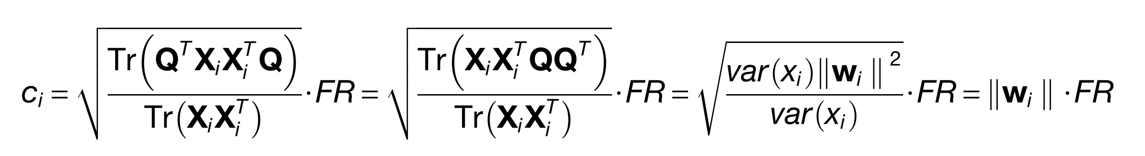
How much does each neuron contribute to each subspace?

Slide 29
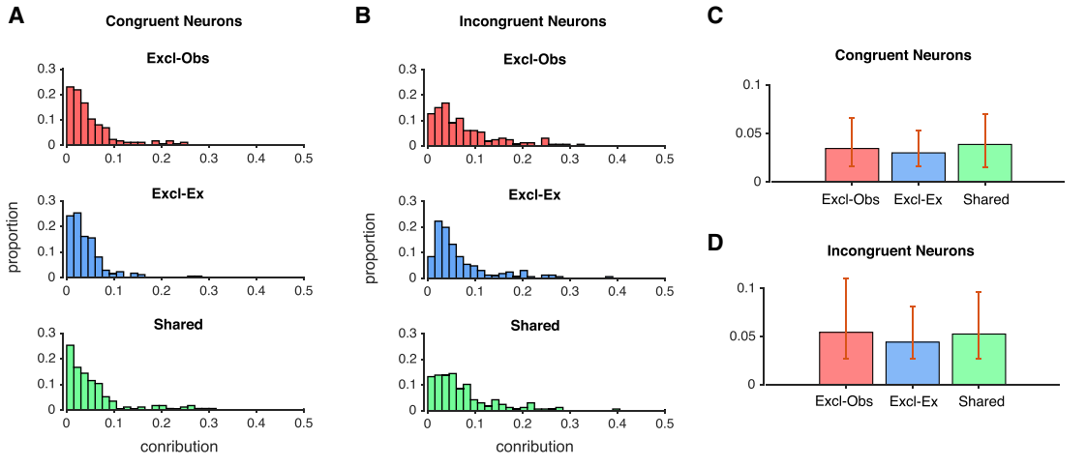
The shared subspace is not merely a collection of congruent neurons
contribution
contribution
contribution

Slide 30
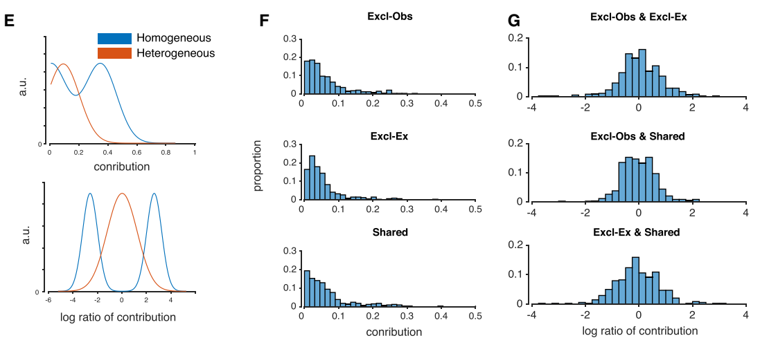
No subspace defines a particular class of neurons – each subspace is a heterogeneous mix

Slide 31
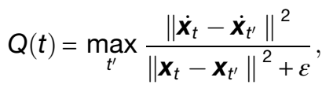
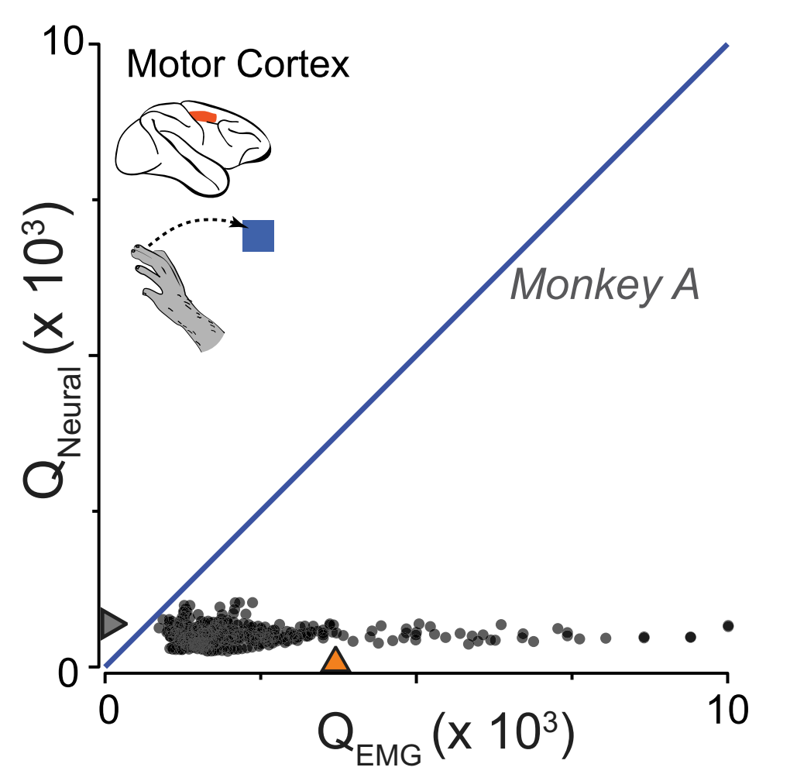
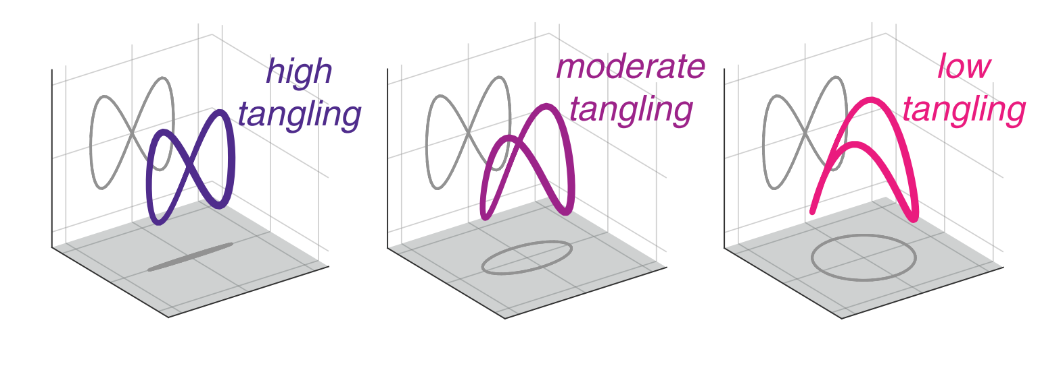
Not just a representation: quantifying dynamical "tangling"
Russo et al. 2018 Neuron

Slide 32
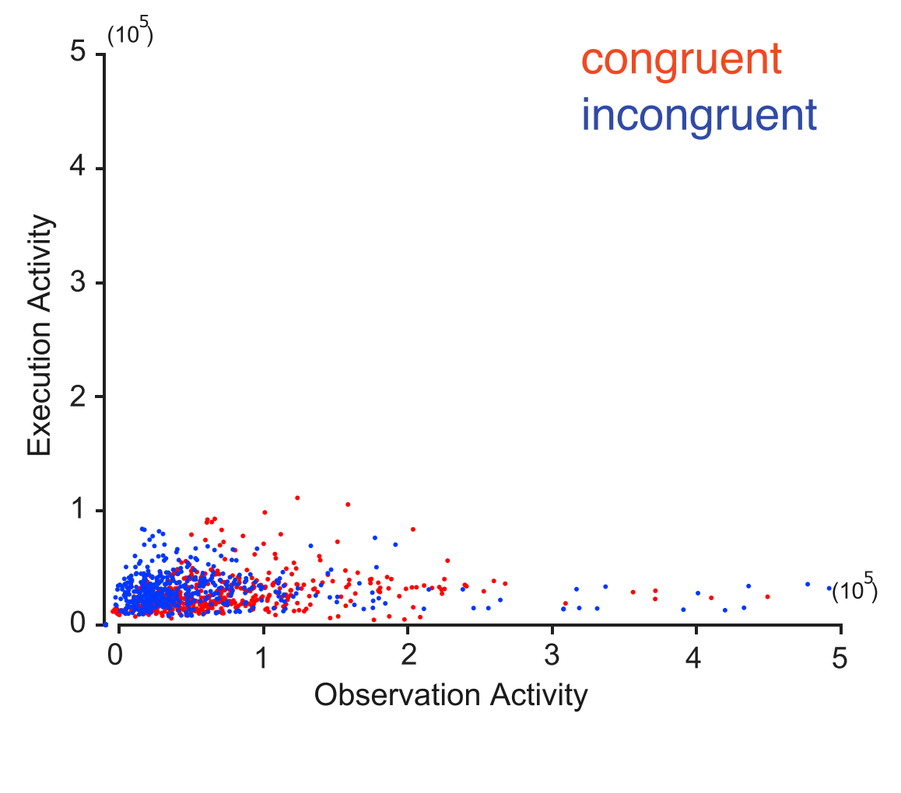
Congruent and incongruent neurons do not define dynamically distinct subspaces

Slide 33
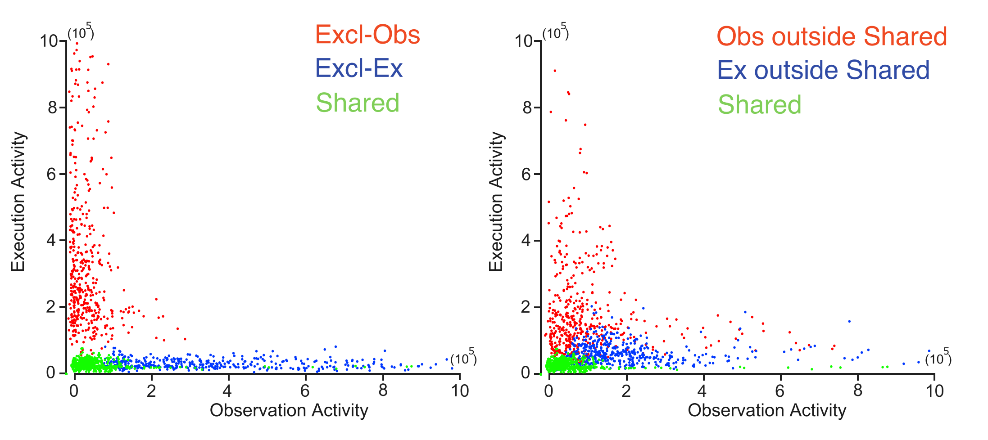
Subspace decomposition reveals where observation activity exhibits low tangling

Slide 34
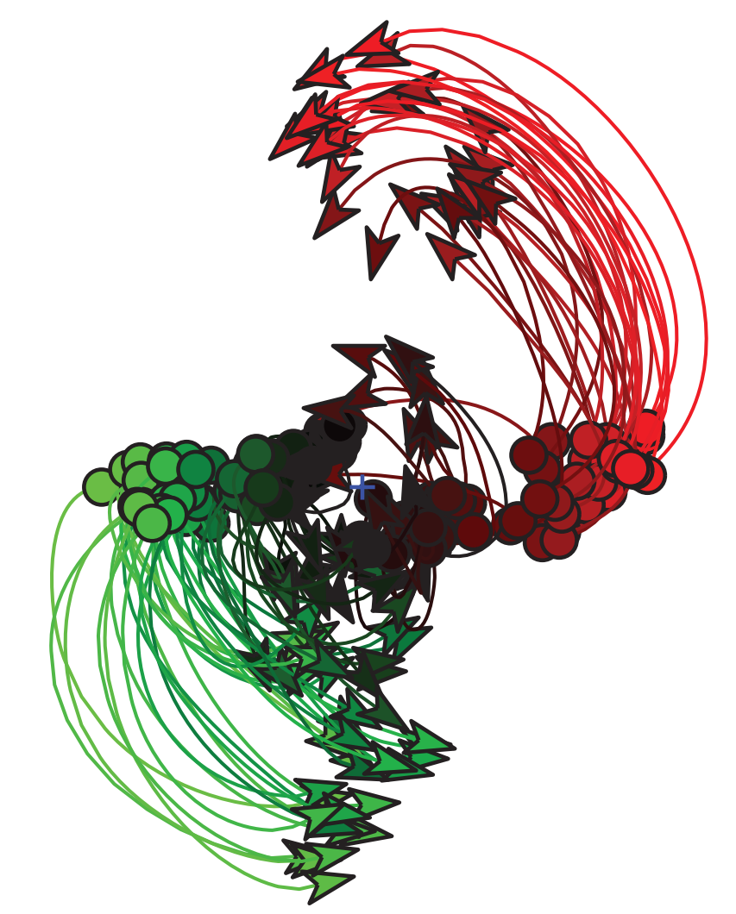
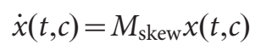
What do these dynamics look like? Returning to jPCA
Churchland, Cunningham, et al. 2012 Nature

Slide 35
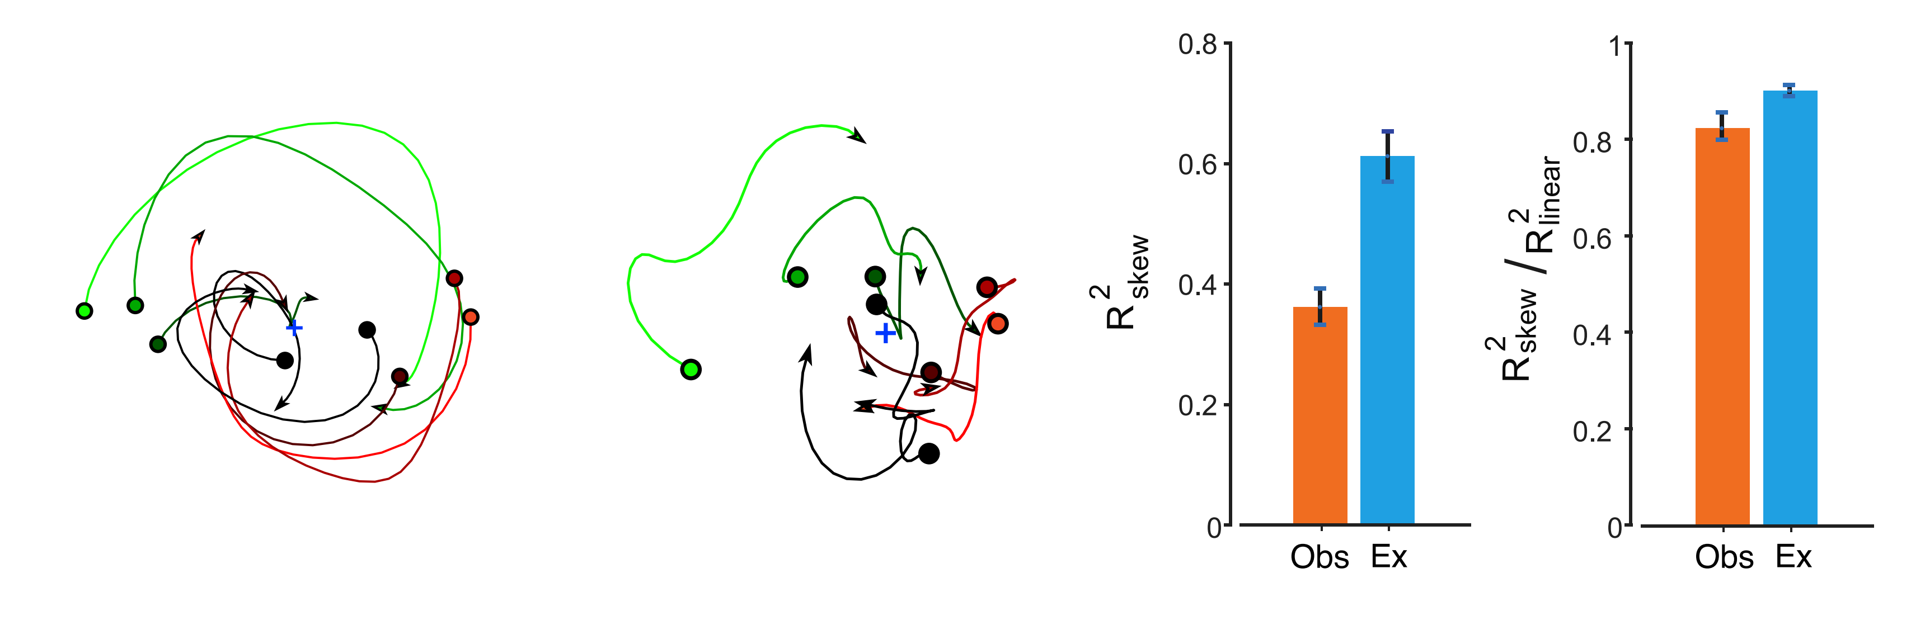
Observation dynamics are weaker, but just as rotational, as execution dynamics
Execution
Observation
Notes:
Note: not shown here, but they report jPCA fits when constrained to just the congruent or incongruent neurons (no difference), or when constrained to just the exclusive or the shared subspace within a given condition (no difference), suggesting rotations are ubiquitous and not constrained to any particular subspace or neuron type

Slide 36
Conclusions
There is no specific class of congruent mirror neurons
Neural state spaces during action and observation are neither orthogonal nor totally overlapping
A "shared" subspace
Two "exclusive" subspaces
Movement information is contained in both the shared and two exclusive subspaces
Activity across all subspaces exhibits rotational dynamics, to the extent those subspaces are explored in a given context
Overall, observation seems noisier than action
Less movement information
Weaker dynamics

Slide 37
Caveats!
No reporting of overall variance / firing rate / SNR within each condition
Only differences in baseline firing rate & modulation depth; both favor execution
How close to zero are we during observation?
These animals have been trained on BCI cursor control
Once more, PMd and M1 are pooled here
No evidence that activity during observation is important for any kind of behavior
Notes:
Second point means: we're probably talking about different repertoires in addition to overlaps / exclusivities of activity within those repertoires defined by being orthogonal / parallel.

Slide 38
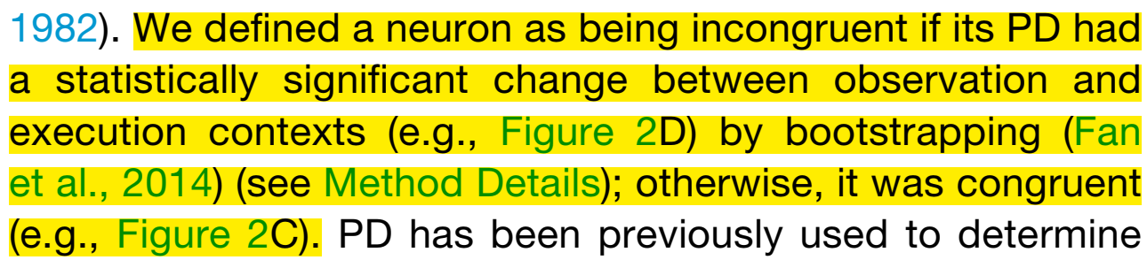
Congruent / Incongruent definition

Slide 39
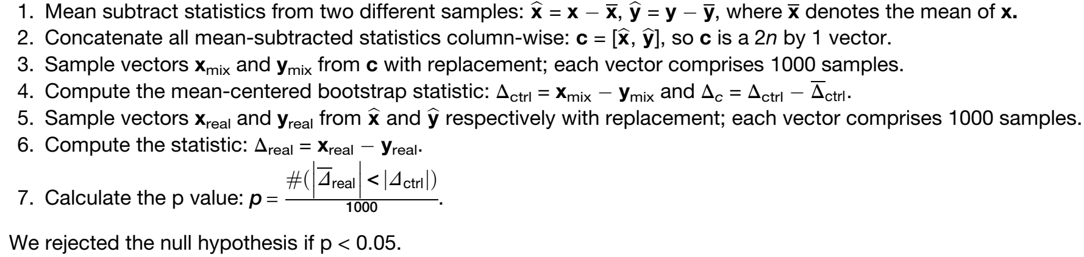
Congruent / Incongruent statistical test

Slide 40
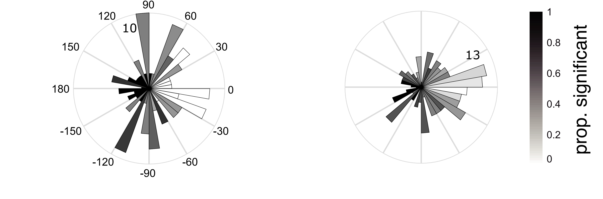
Distribution of neurons' preferred direction shifts between action and observation
Monkey 1
Monkey 2

Slide 41
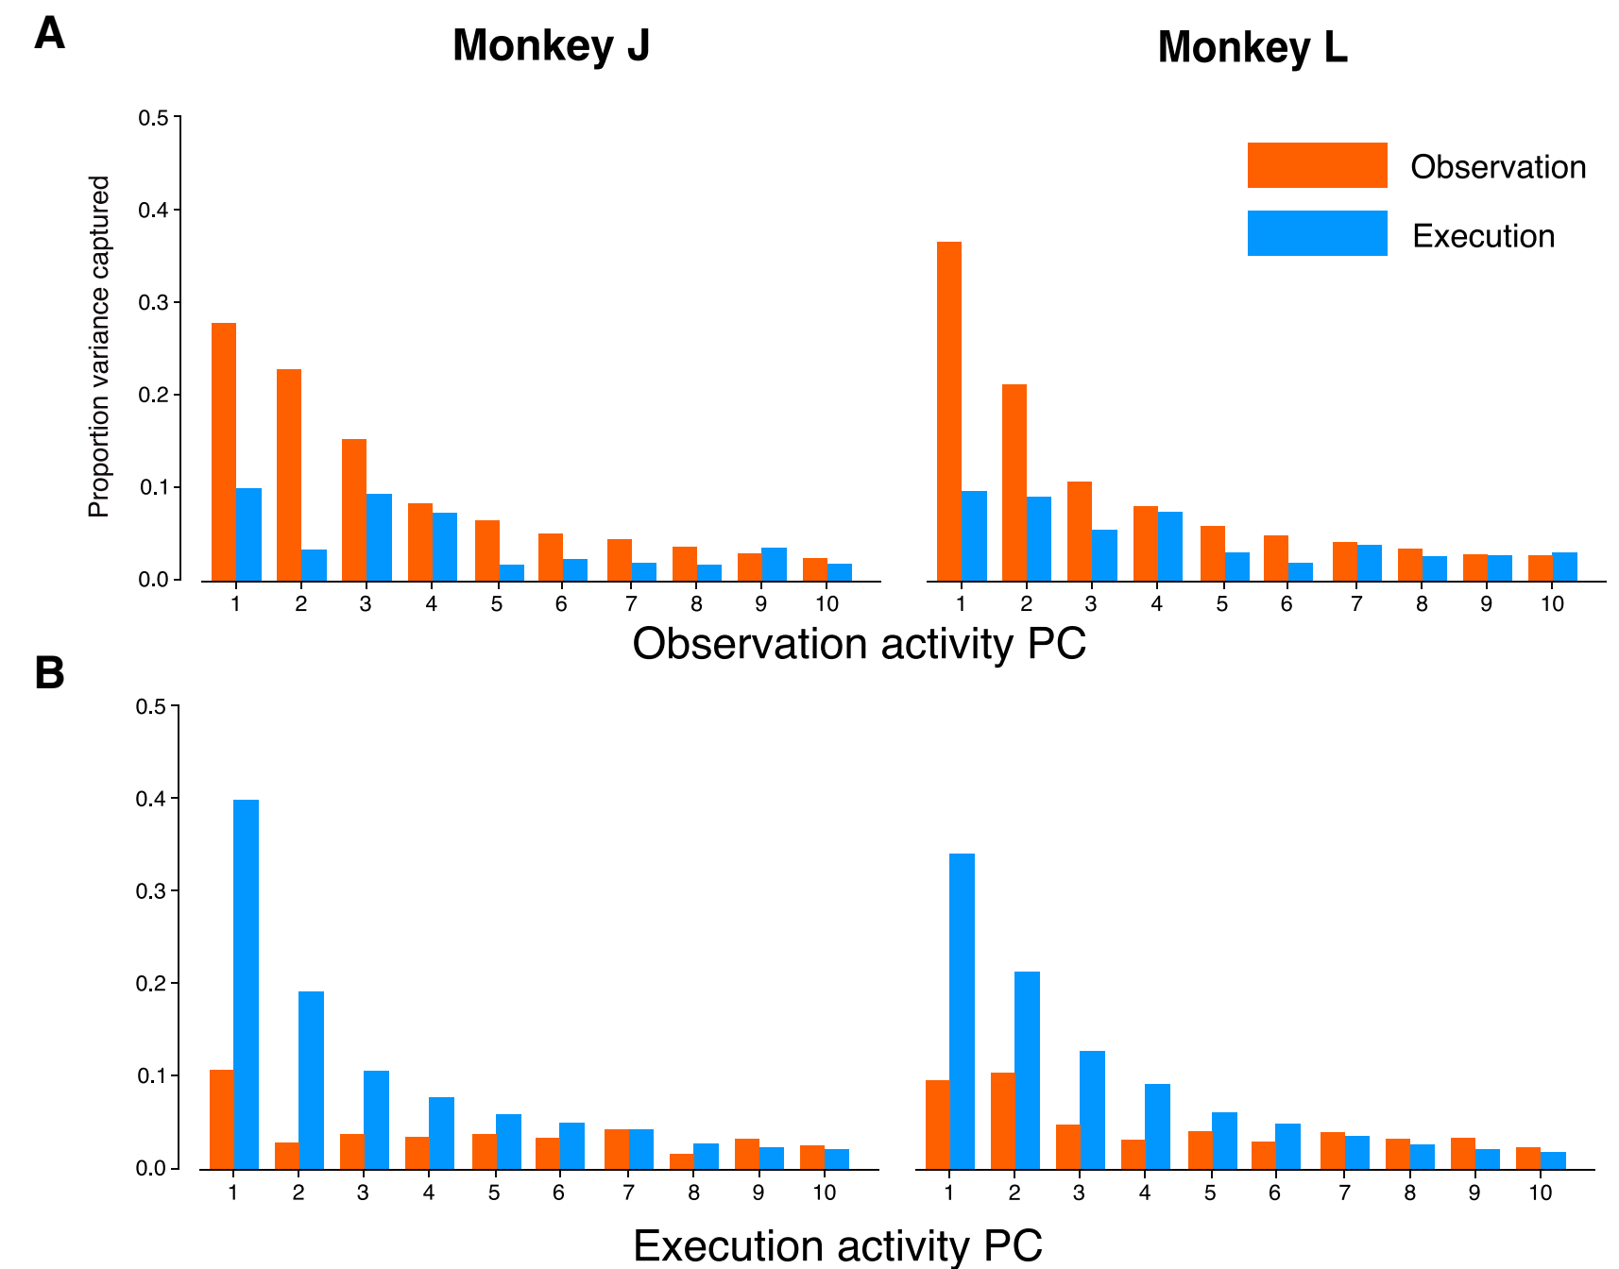
PCA projection and cross-projection scree plots

Slide 42
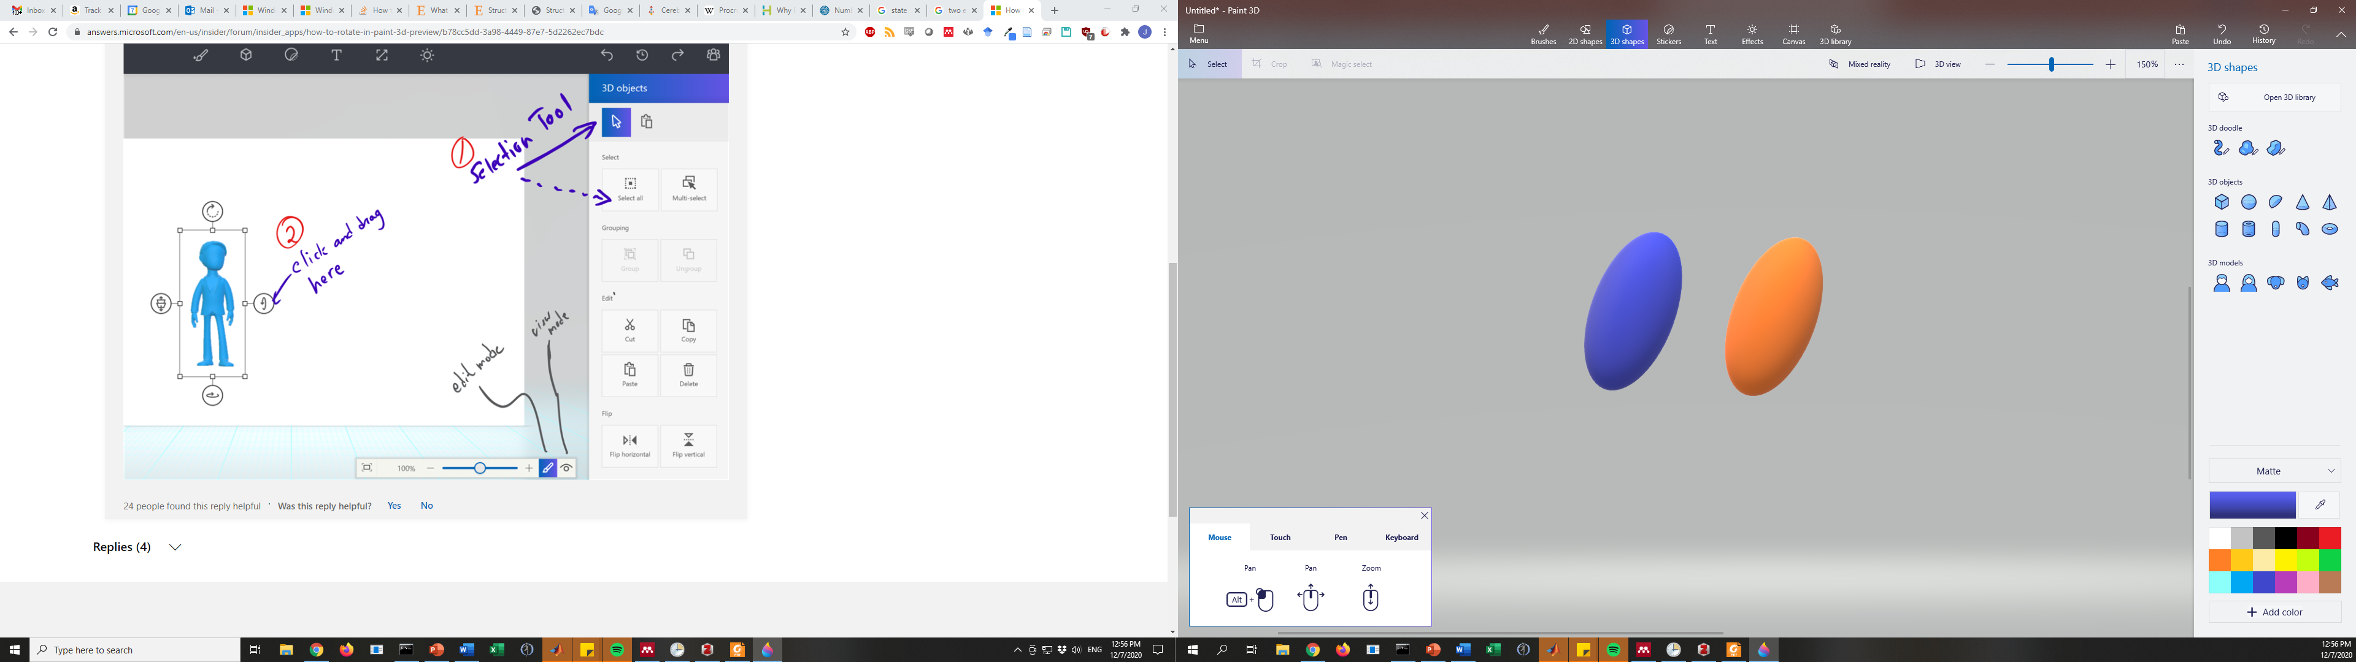
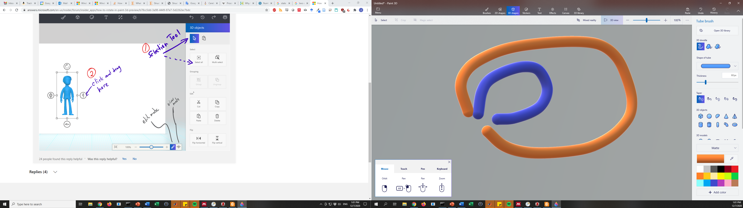
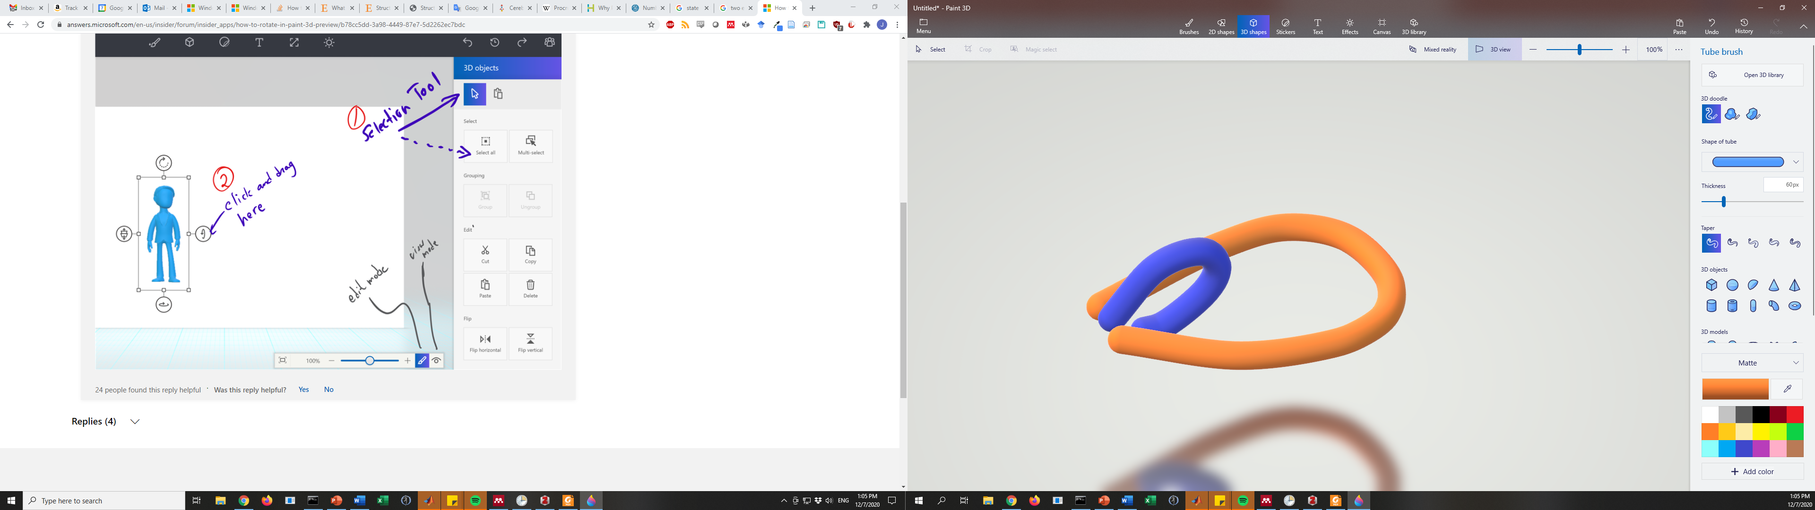
Notes on repertoire vs. subspace testing
Distinct repertoires
Same subspaces
DIFFERENT BASELINES
If similar baselines,
Then distinct repertoires
Can appear as a "shared subspace"
Or at least
Partially overlapping

Slide 43
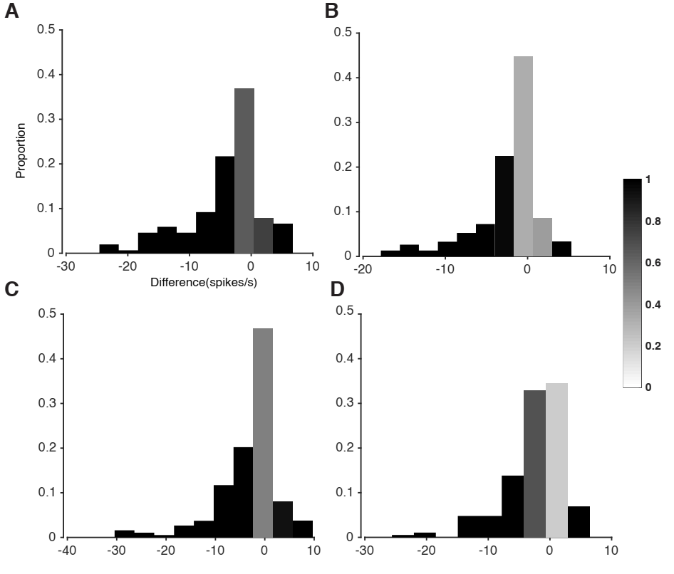
Change in Firing Rate & Modulation Depth, Action vs. Observation
Monkey 1
Fraction significantly nonzero
Monkey 2
Baseline firing rate
Modulation Depth
Notes:
Mod depth = range (max – min)
Difference is observation minus action
(these are, I believe, in Hz

Slide 44
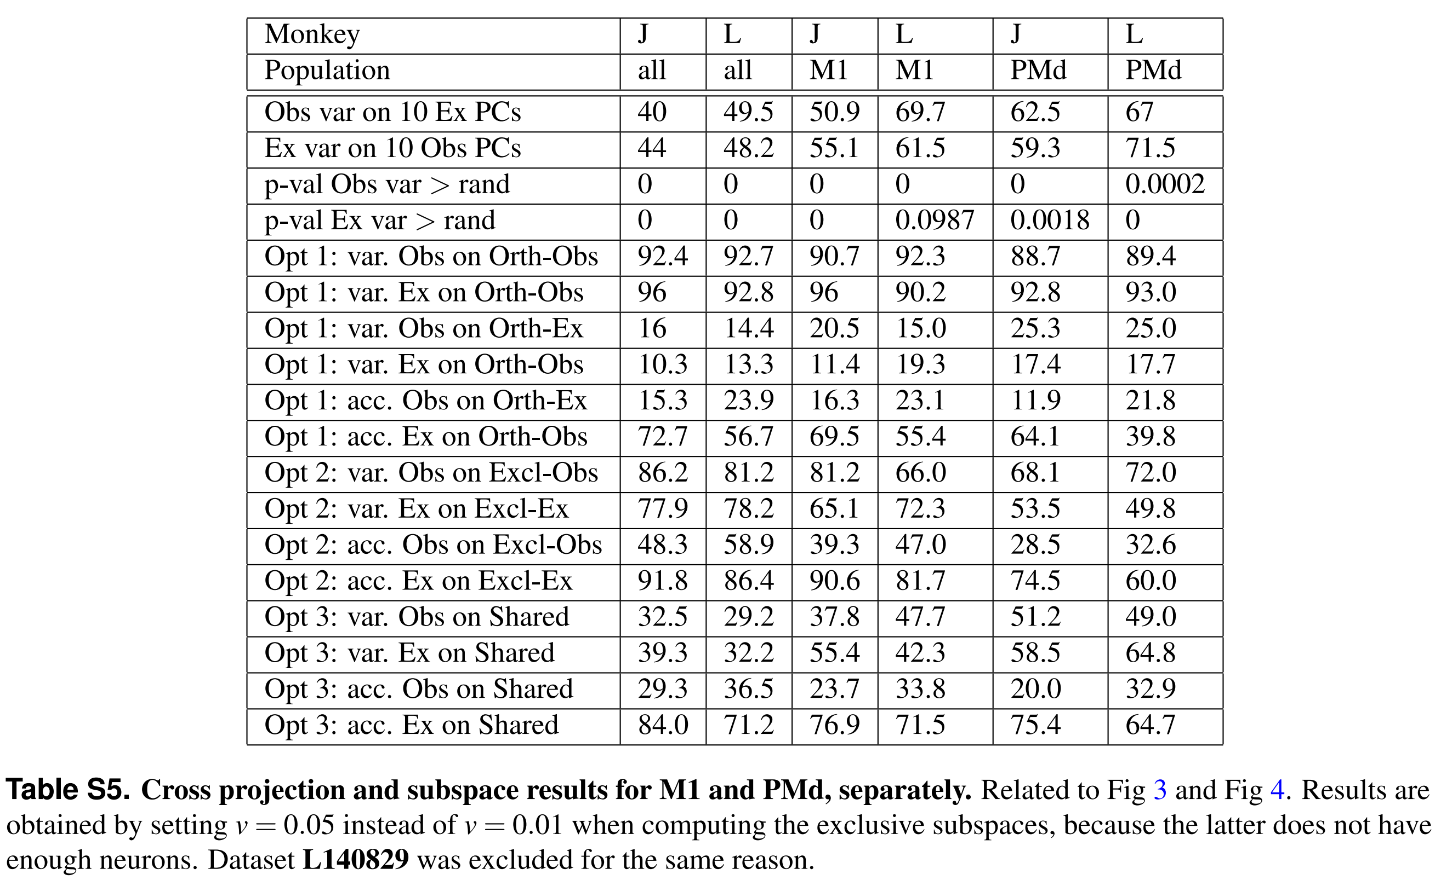
Justification for pooling M1 and PMd arrays
Notes:
Essentially: the results are similar for both areas, and pooling them gives us greater statistical power

Slide 45
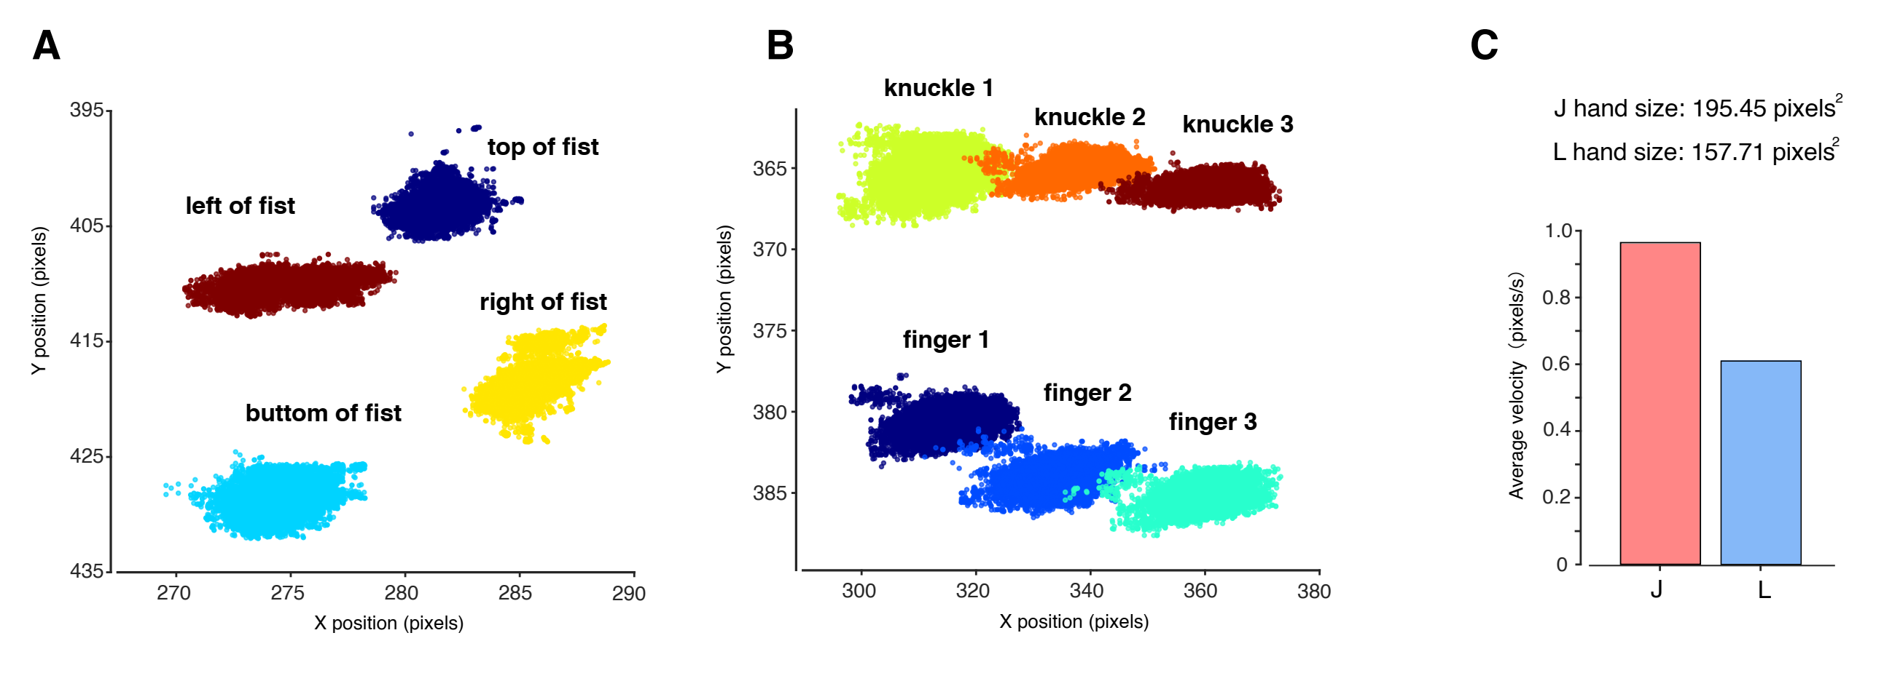
DLC to verify lack of movement during observation
Monkey 1
Monkey 2
Notes:
Oh
But they restrained the hand
So like, of course the hand ain't gonna move
(I guess the fingers are left free, at least)

